Slide 1
Series / Parallel Circuit
Current=X
Current=Y
+
BATTERY
LED
Current=X
LED
LED
-
LED
Current=Y/2
Current=X
Current=Y
Series
Parallel

Slide 2
Conducting or Non-Conducting Material
+
LED
BATTERY
Connectors
-

Slide 3

Nuclear Fission
Chain Reaction

Slide 4
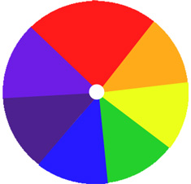
Newton's Color Disk

Slide 5
Potentiometer – a variable resistor
Potentiometer
LED
LED
BATTERY
+
-

Slide 6
Switches in Series combination
Switch
Switch
LED
BATTERY
+
-

Slide 7
Switches in Parallel combination
LED
Switch
Switch
BATTERY
+
-

Slide 8
Working of Capacitor
Switch
Switch
Capacitor
LED
BATTERY
+
-
Charging Loop
Discharging Loop

Slide 9
Capacitors in Series combination
Capacitor
Capacitor
Switch
LED
BATTERY
+
-

Slide 10
Capacitors in Parallel combination
Switch
Capacitor
Capacitor
LED
BATTERY
+
-

Slide 11
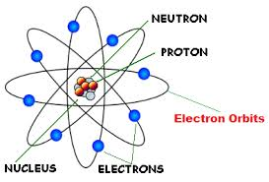
Rutherford atomic model

Slide 12
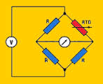
Wheatstone Bridge

Slide 13
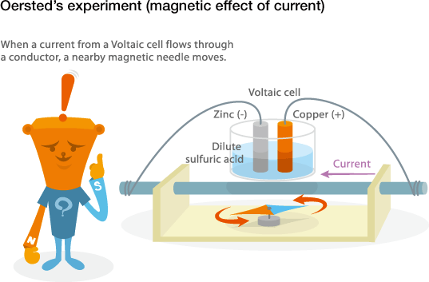

Slide 14
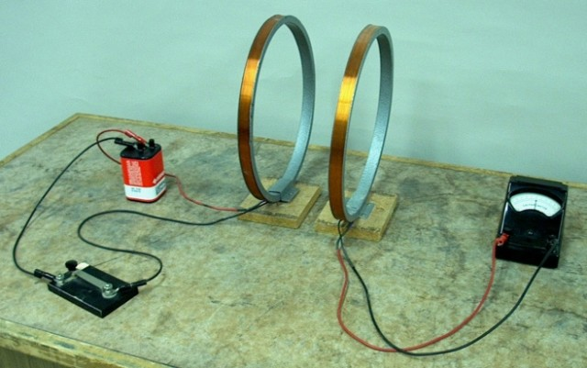

Slide 15
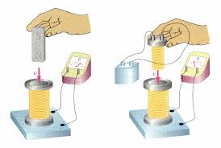

Slide 16
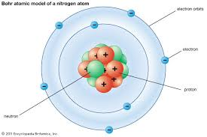

Slide 17
Bohr Atomic Model of Nitrogen Atom
Orbit
e-
e-
e-
Electron
Proton
+
e-
e-
e-
Nucleus
e-
Neutron

Slide 18
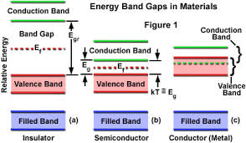

Slide 19
Working of Diode
No Current
Current
LED
Diode
Diode
LED
BATTERY
BATTERY
+
-
+
-
Forward Biased
Current flows
Reverse Biased
Current does not flow

Slide 20
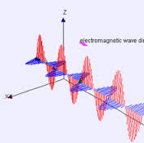

Slide 21
Electronic Piano
+
BATTERY
-
Speaker

Slide 22
Light Dependent Resistor
LDR
LED
BATTERY
+
-

Slide 23
Electromagnetic Induction

Slide 24
Steady Hand Tester
Wire Loop
BUZZER
BATTERY
+
-
BUZZER

Slide 25

Relay and Electromagnetism
Switch
LED
+
BATTERY
BATTERY
+
-
-
LED

Slide 26
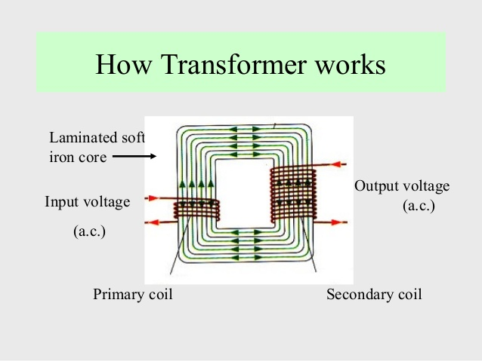
Transformer

